Slide 1
Air Pollution in Cyprus
2018-2023
Author: Marinos Kaitis
Date: 21 April 2024

Slide 2
Table of contents
Introduction
Data
Where does it come from
What it consists of
Methods
How the data was manipulated
What tools were used
Discussion
What parts of the data we are looking at
Explanation of Index /Pollutants
Yearly trends
Results
What story the data tells us and how
Tableau Dashboard
Summary
Appendix

Slide 3
Introduction
We all want the ability to breath clean air so we can have a healthier life and that is why people consider air quality when planning a vacation.
With the transition to electric vehicles, and solar power investments growing around the globe we will see the impact on the Air Pollution on the island i live in ( Cyprus ) .
Cyprus is a beautiful island and a very popular vacation destination for all people (Europeans especially) as it has warm weather and sandy beaches.
It consists of 1.251 million current population and growing, as due to nice weather and good taxation system many people and businesses started moving here.

Slide 4
Data
Where is the data from ?
Official Website of Cyprus Government
Data is gathered from 9 stations around the island.
5 Traffic
2 Industrial
1 Background
1 Residential
Consisted of hourly measurements ( in μm/m3 - micrometers( microns ) ) for each pollutant, for each of the stations, with some pollutants like PM10 and PM2.5 been daily measurements.
Inconsistencies
Missing Values (N/A)
Measurement organ malfunction
Measurement organs maintenance
Power Outbreak
Each station does not measure all pollutants.
Values Below Detectable Level ( BDL )

Slide 5
Methods
Missing Values and BDL values were removed from the Data ( total of 763 572 rows)
Data was then uploaded to BigQuery and R studio , which helped Transform it into a meaningful tables
Calculated Daily averages for each pollutant for each station
Converted Pollutant_ids and Station _codes into their corresponding names from different tables using SUBQUERIES and JOINS
Merged all data into a final working table using UNIONS
Calculated Air Quality Index and categorized it into Level values
Further analyzed using
Pivot Tables and Charts in Excel
R-Studio
Tableau
Notes:
Missng values and values BDL were removed

Slide 6
Discussion
What was the pollution change for those years?
Yearly trend for the 5 major pollutants
Correlation of Pollutants with Air Quality Index
Monthly Comparison
Certain months have higher / lower quality than others ?
Difference on Air Quality Index between
Industrial
Non-industrial station areas

Slide 7
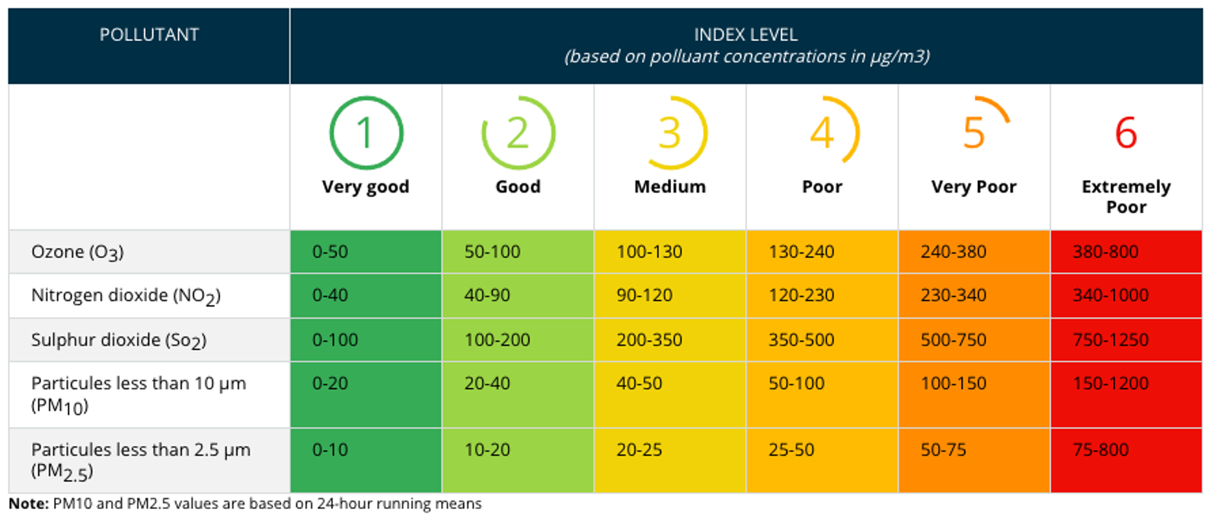
Air Quality Index
The 5 major air pollutants which are considered when calculating Air Quality Index based on European Guidelines
Nitrogen Dioxide ( NO2 )
Ozone ( O3 )
Sulphur dioxide ( SO2 )
Particulate matter <10 microns in mass ( PM10 )
Particulate matter <2.5 microns in mass ( PM2.5 )
Categories of Index and Values :
Table from Atmosphere Monitoring Service
Notes:
The index is basically the max value from the pollutants in the list for the day.

Slide 8
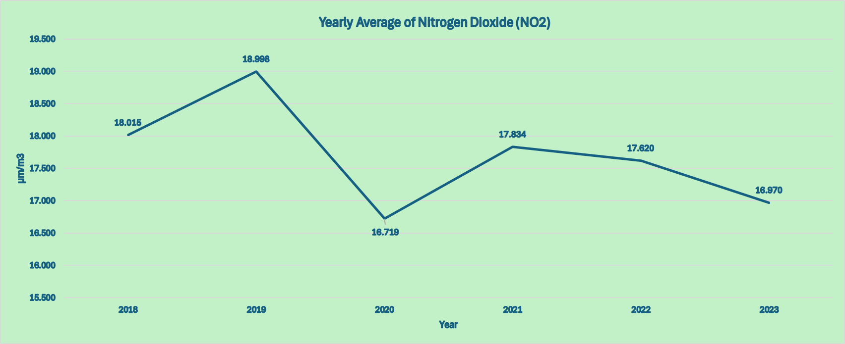
Nitrogen Dioxide (NO2)
Nitrogen Dioxide is formed through the oxidation of nitric oxide(NO) from combustion processes such as diesel engines and coal, oil, gas, wood and waste plants.
It dissolves in water vapour to create acid rain.
Contributes to the formation of ground level Ozone(O3), and forms Particulate Matter(PM2.5) when combined with other atmospheric compounds such as ammonia.
It has an adverse effect on respiratory systems of both humans and animals, increasing risks of stroke.
NO2 : 0.0 - 20.0 μm/m3
NO2 : 20.0 - 40.0 μm/m3 per EU Environmental Agency
Notes:
Note : the chart’s y axis is not set to 0 …. The change over the years is insignificant if set to 0 so i wanted to show you how the change goes

Slide 9
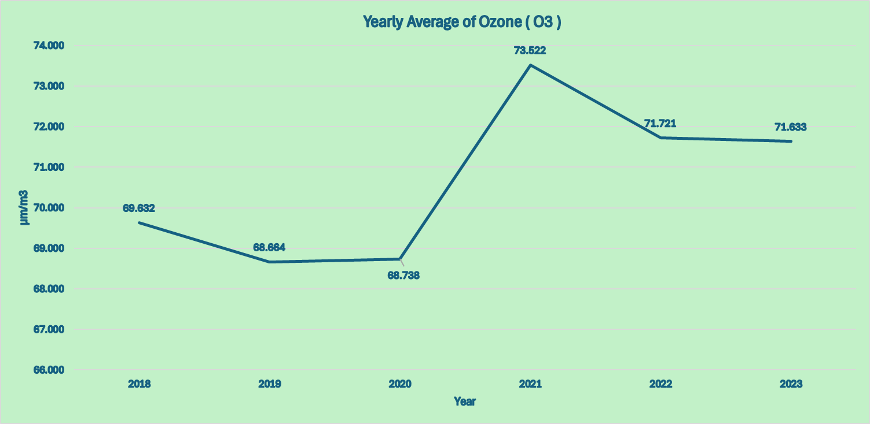
Ozone (O3)
Ground- level Ozone is a play blue gas with a pungent smell and is mainly formed through the photochemical reactions of other pollutants such as nitrogen oxides(NO), carbon monoxide(CO), and volatile organic compounds from strong sunlight and UV radiation.
Indoor sources consists of electric motors in appliances such as copiers and laser printers.
It is suspected to have carcinogenic effects, and also leads to reduced lung function and respiratory diseases, with exposure linked to premature mortality.
Damages vegetation, contributing to a decrease in crop productivity and forest decline.
Accelerates the deterioration of rubbers, dyes, paints, coatings, various textiles and is also a major component of smog.
O3 : 100.0 - 120.0 μm/m3
O3 : 120.0- 140.0 μm/m3 per EU Environmental Agency

Slide 10
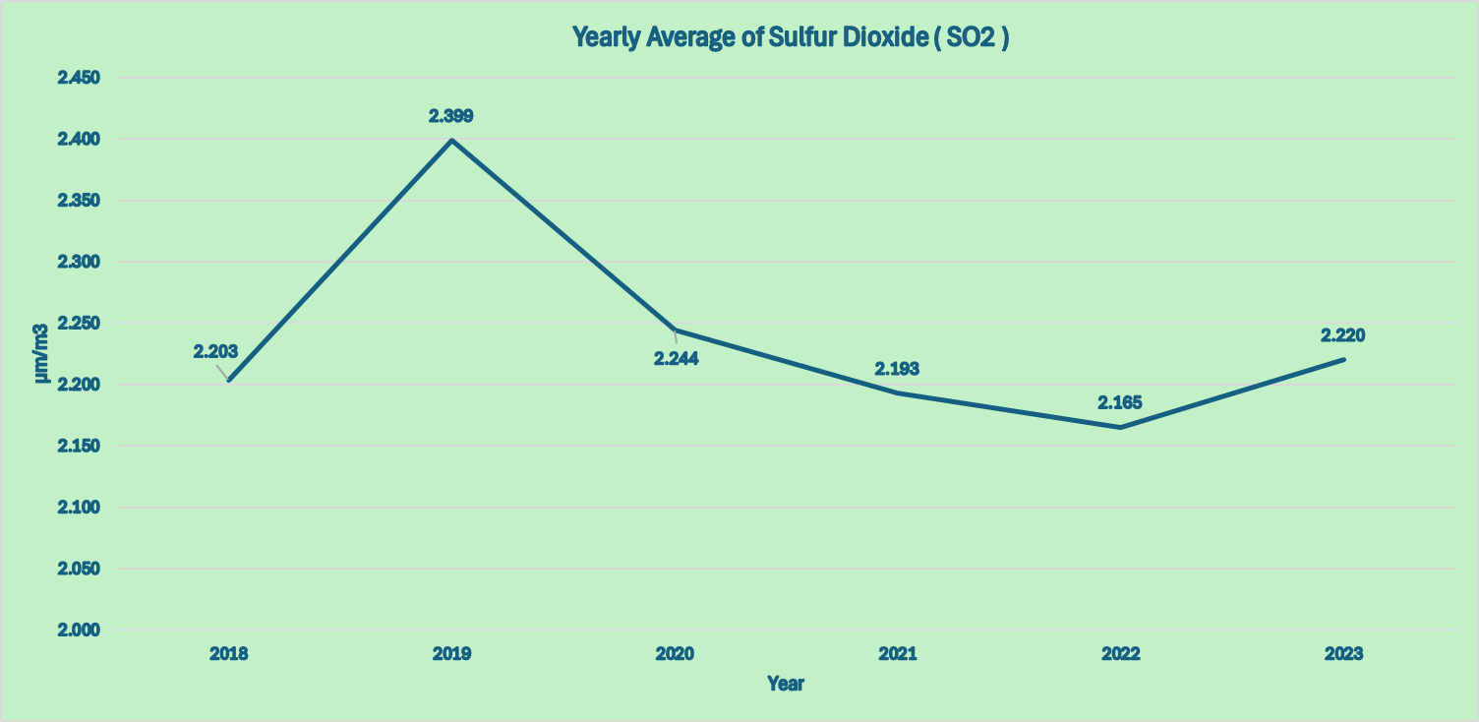
Sulphur Dioxide (SO2)
Sulphur dioxide is a toxic gas with a pungent smell.
It mainly arises from the combustion and refining process of coal, oil, and metal containing ores but also from transport-related emissions such as shipping.
It is an irritant , and can cause respiratory diseases in both humans and animals .
When dissolved in water it forms acid rain which damages vegetation, buildings and materials, and contributes to the acidification of terrestrial and aquatic ecosystems.
Also forms secondary Particulate Matter(PM2.5) when combined in the atmosphere with compounds such as ammonia.
SO2 : 0.0 - 40.0 μm/m3
per EU Environmental Agency

Slide 11
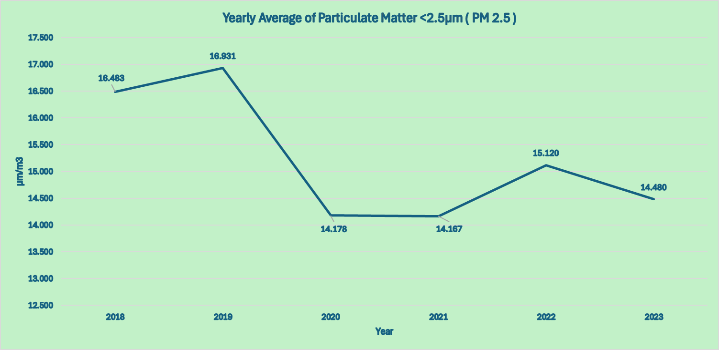
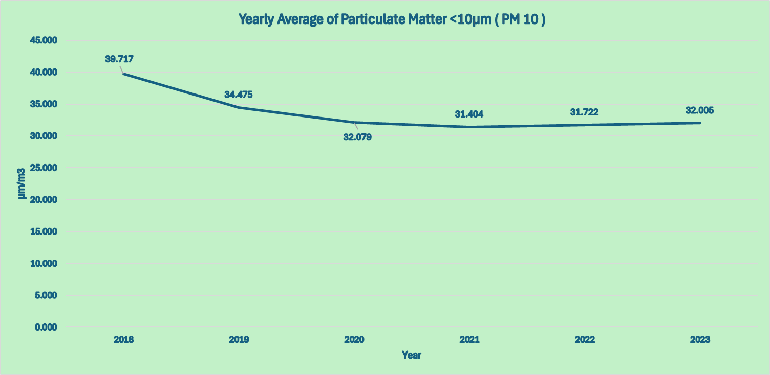
Particulate Matter (PM)
PM2.5 : 0.0 - 10.0 μm/m3
PM2.5 : 10.0 - 20.0 μm/m3
per EU Environmental Agency
Particulate Matter consists of airbourne liquid and solid particles.
Primary particulate matter is usually emitted from direct sources, including power plants, vehicle traffic, construction sites and indoor stoves or heaters.
Secondary particulate matter is formed as a result of chemical and physical reactions with various compounds such as Sulphur Dioxide(SO2), Nitrogen Dioxide(NO2) and Ammonia(NH3).
It has been linked to cardiovascular and respiratory diseases such as asthma, bronchitis, and emphysema.
The extent of health damage is determined by the size of the particles. The smaller the particle, the higher the risk, due to its ability to penetrate deeper into the respiratory and circulatory systems , causing damage to the lungs, heart and brain.
Particles with a mass median diameter of less than 10 microns is called PM10 , while particles with a mass median diameter of less than 2.5 microns is called PM2.5.
PM10 : 20.0 - 40.0 μm/m3
per EU Environmental Agency

Slide 12
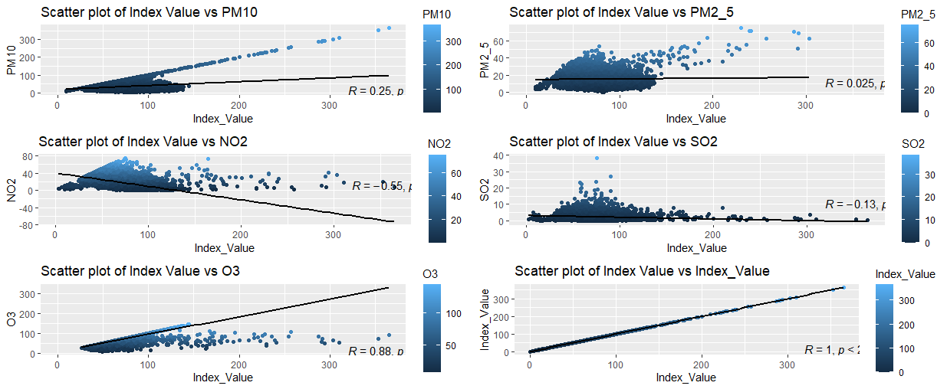
Correlation Between Pollutants And Index Value-1
Linear Regression
Notes:
The closer to 1 the R-squared value the higher the correlation.

Slide 13
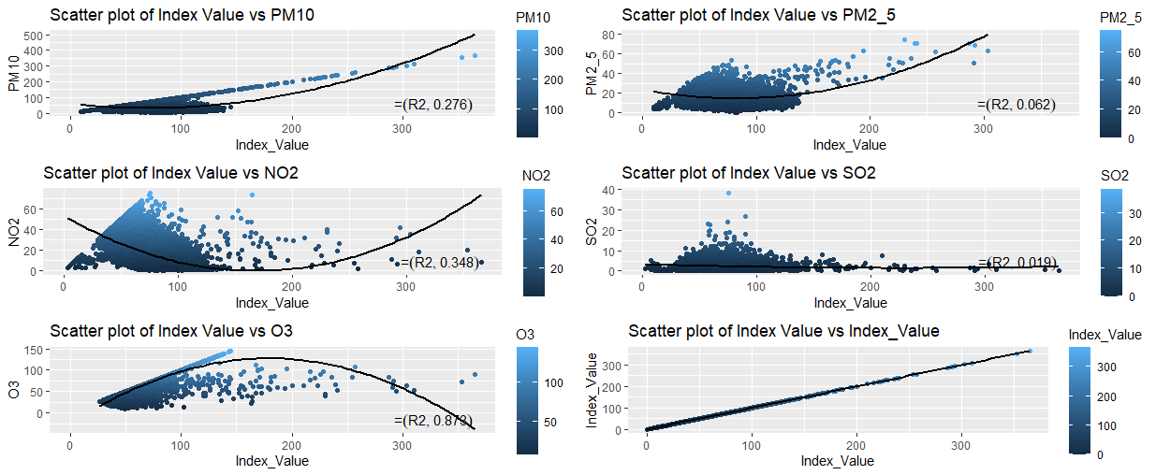
Correlation Between Pollutants And Index Value-2
Second Order Polynomial

Slide 14
Results
We can see the overall trend of the major Pollutants for the years heading downwards which implies the Air Quality is getting better year by year.
Even though the change of each of them is minimal for the area there the contribution on Air Quality is still significant.
While testing for correlation between Pollutants and Index Value we can see that the only Pollutant that is really correlated with Air Quality in Cyprus is Ozone (O3)
High temperatures of the island.
When looking at the Air Quality Index we can validate this results.

Slide 15
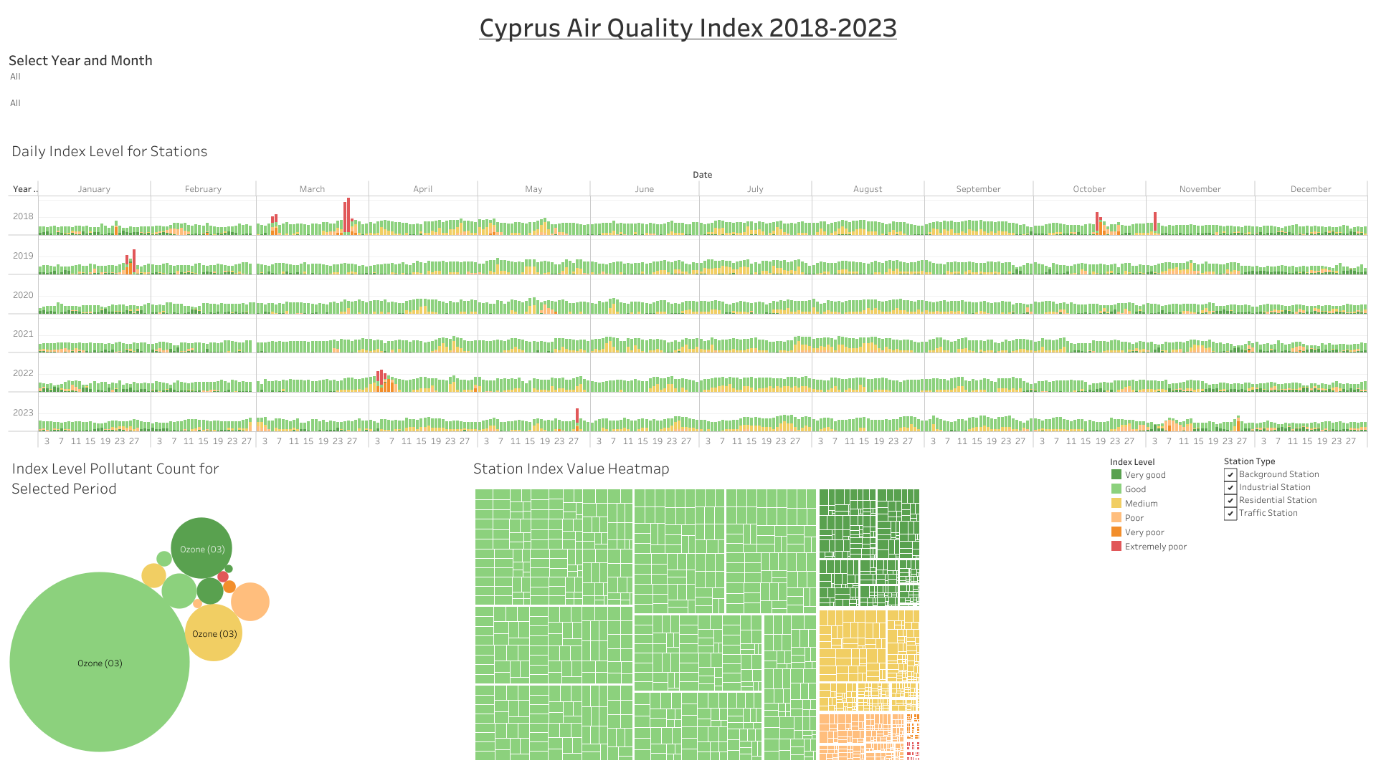
Dashboard of Air Quality
https://public.tableau.com/app/profile/marinos.kaitis/viz/GoogleDataAnalyticsCapstoneProject_17137238543110/Dashboard1
Notes:
The bar chart on the top shows the avg daily Index value sectioned by Station Type and colored by level
The 2 charts in the bottom show the distribution of Pollutants contributing in that level ( on the left ) as well as section by station and date (on the right )

Slide 16
Results (continued )
In the last 4 years the Average Air Quality was between Very good and Medium with exceptions only in April 2022 and May 2023 that had some days of Poor - Extremely Poor Levels
The main pollutant contributing for Cyprus Air Quality is Ozone ( O3 ) and it is mostly on Good and Very good levels . The most serious Pollutant for health ( PM 2.5 ) never comes as an Index of Pollution in Cyprus even though it is correlated a bit with the Index Value
The higher pollution mainly comes from Traffic Stations where the emission from cars is concentrated.

Slide 17
Summary
The majority of the Quality of Air in Cyprus falls into 3 Categories
Very good
Good
Medium
The months from May until September have at the worst a Medium Average Index Value which is really good considering the high UV radiation from the sun during those months.
The only pollutant that made Air Quality in Cyprus to go in Very poor and Extremely poor levels is the Particulate Matter <10 μm/m3 and that was mainly in 2018 with few exceptions around the years and not on every station.
The only Pollutant with serius correlation on Cyprus’s Air Quality Index is Ozone ( high temperatures )
The overall trend of Pollutants is Downwards which makes Cyprus a decent Country when it comes to Air Quality.

Slide 18
Appendix
Citation
Atmosphere Monitoring Service - European Air Quality Index Calculation
https://ecmwf-projects.github.io/copernicus-training-cams/proc-aq-index.html#:~:text=The%20overall%20hourly%20European%20Air,overall%20index%20will%20be%203.
Breeze Technologies /Major air pollutants, their impact and sources
https://www.breeze-technologies.de/blog/major-air-pollutants-their-impact-and-sources
Cyprus Government National Open Data Portal
https://www.data.gov.cy/el/dataset/oriaies-metriseis-atmosfairikon-rypon-istorika-stoiheia
https://www.data.gov.cy/el/dataset/imerisies-metriseis-aioroymenon-somatidion-stin-atmosfaira-istorika-stoiheia
European Environment Agency
https://www.eea.europa.eu/themes/air/country-fact-sheets/2023-country-fact-sheets/cyprus-air-pollution-country
https://www.eea.europa.eu/publications/status-of-air-quality-in-Europe-2022/europes-air-quality-status-2022/world-health-organization-who-air

Slide 19
Special Thanks
Dr. Chrysanthos Savvides
Senior Labour Inspection Officer - Air quality Section Head
Cyprus Department of Labour Inspection
Cyprus Ministry of Labour and Social Insurance
for providing Data information and clarification

